Slide 1
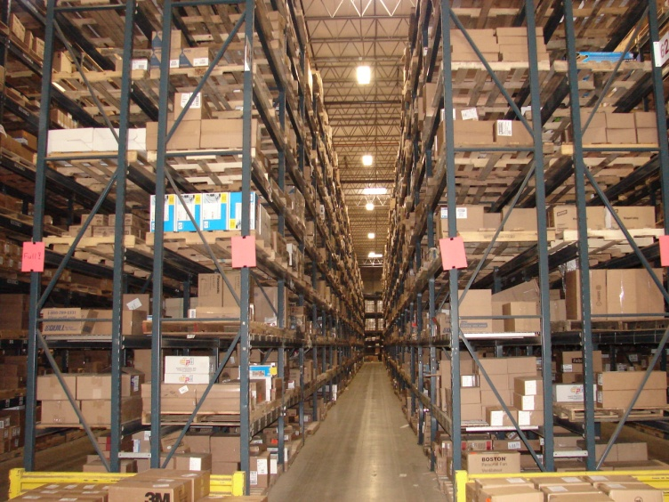
Energy Efficiency Solutions

Slide 2
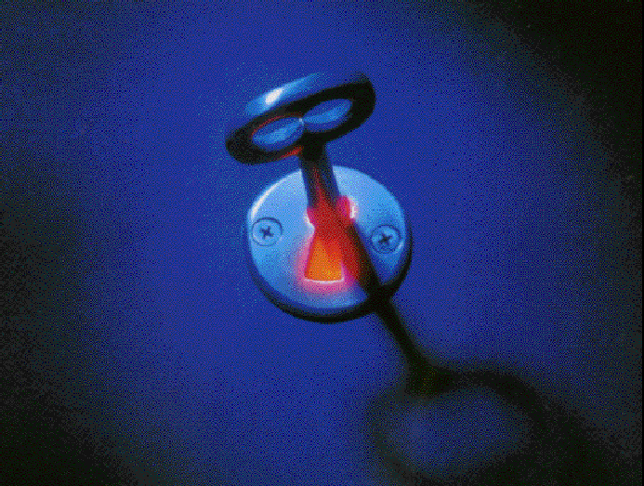
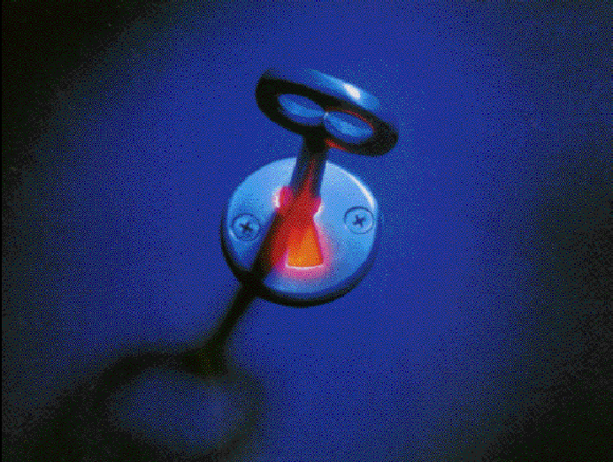
GreenTech Energy Services -
Who We Are
Design Engineer Install
Project Manage

Slide 3
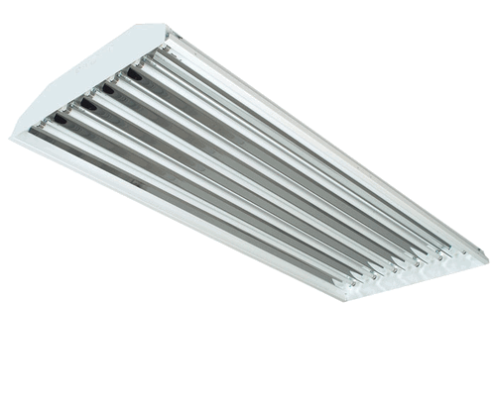
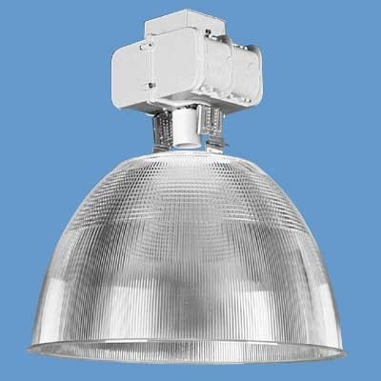
Why Upgrade?
Energy Efficiency
Metal halide high bay is 70-75% efficient, most T5 HO and T8 fixtures’ efficiency ratings are above 90%.
Using less energy cuts utility bills.

Slide 4
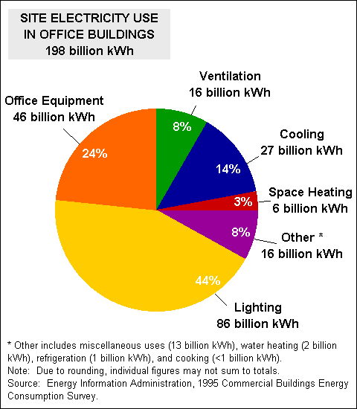
More electricity is used to power lighting than any other building system.

Slide 5

New Federal Ballast Rule
Rule published Sept., 2000
Manufacture of magnetic ballasts discontinued after Mar., 2005
Sale of magnetic ballasts prohibited after June, 2009
T12 lamps being phased out of production

Slide 6

Rebates
Significant rebates still being offered by utility companies for lighting projects. Take advantage of that money while it’s still available.

Slide 7
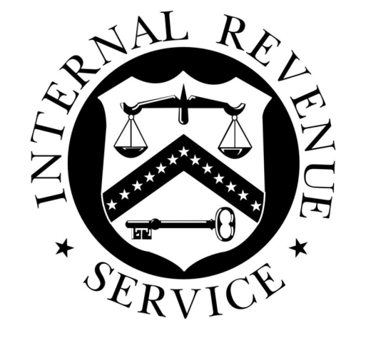
Tax Incentives
EPACT (the Energy Efficient Commercial Buildings Tax Deduction) - write off the complete cost of indoor lighting project in the year it’s placed in service, capped at $.60/square foot.

Slide 8
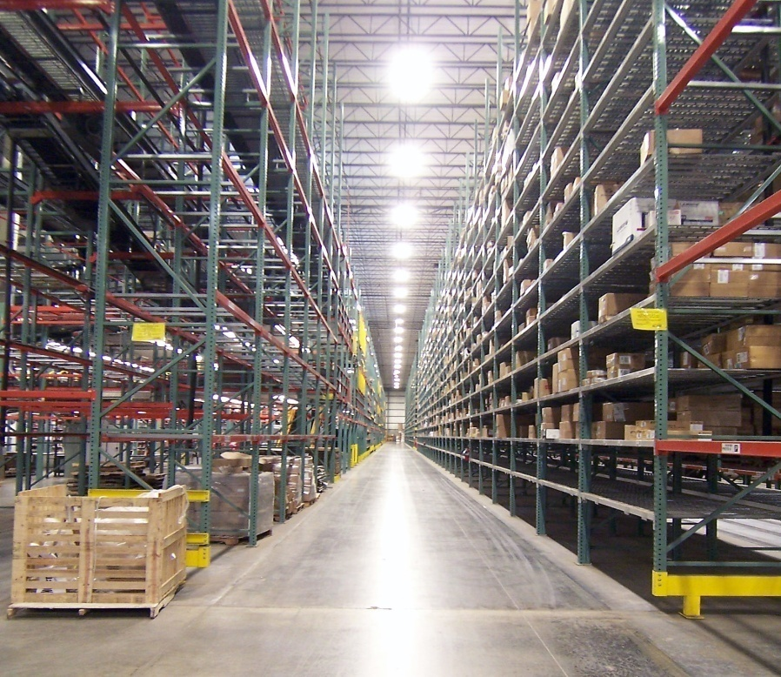
Light Quality
New lighting reduces glare, improves contrast ratios, eliminates buzzing and flickering, enhances aesthetics of the building, and improving safety and productivity for workers.

Slide 9

Corporate Responsibility
Older lights consume more energy and increase carbon emissions than newer technology.

Slide 10
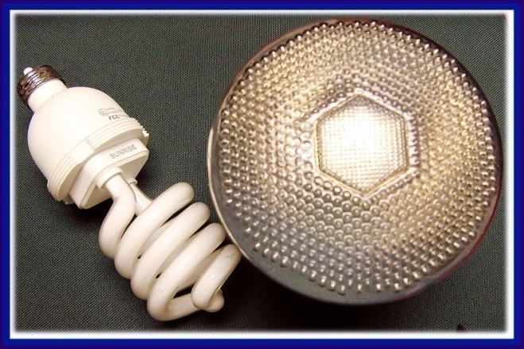
UPGRADE STRATEGIES
Eliminate all T12 & other obsolete technology
  Retrofit
  New Fixture
  Total Redesign
Controls, Occupancy Sensors
New Technology (LED exit signs, Par lighting, Induction)

Slide 11
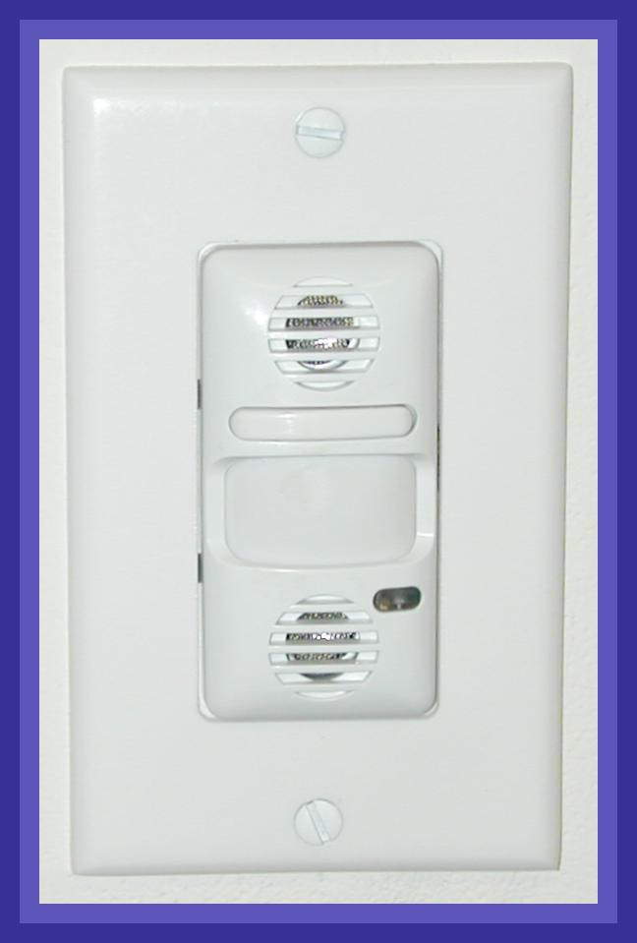
LIGHTING CONTROL OPTIONS
Fixture Sensor
Room Sensor-Dual Technology
Building Automation with Lighting Option
Time Clock
Photo Cell

Slide 12
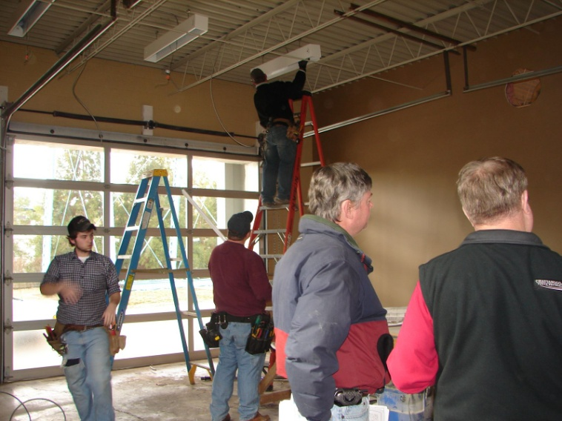
Turnkey Approach
Audit & Design
  Room by room survey
  Study of utility bills
  Analysis of operating schedule and environment
  Light meter readings
  ROI calculation

Slide 13
Turnkey Approach
Installation & Beyond
  Materials procurement
  Project scheduling & management
  Monitoring savings
  Lamp recycling
  Manufacturer’s warranties
  EPACT tax deduction/rebates
  Market support – case studies to document savings, news releases

Slide 14
Technical Benefits
Improved Lighting
  Increased light levels
  Increased lumen maintenance
  Reduced eye fatigue
  Improved visual environment (CRI)

Slide 15
Financial Benefits
Payback Driven Project
  Energy consumption reduced
  Maintenance costs reduced
  Recycling costs reduced
  Government and utility $$ incentives

Slide 16
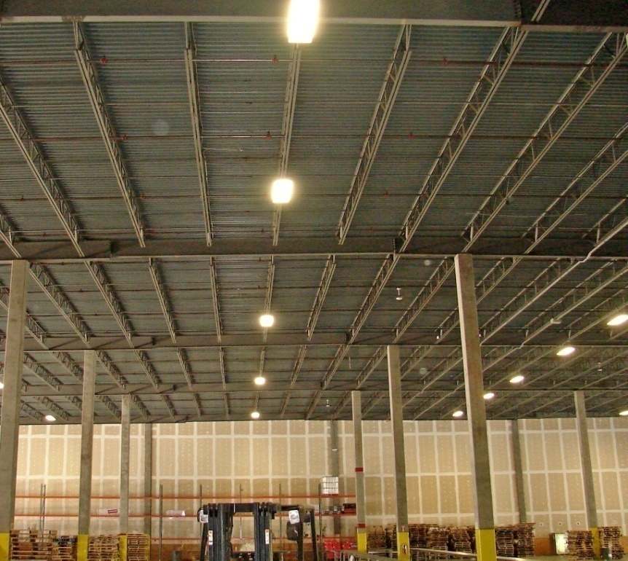
200,000-Sq-Ft Distribution Center
ENVIRONMENTAL IMPACT
Reduction in Carbon Dioxide (pounds) | 1,351,629
Reduction in Sulfur Dioxide (grams) | 5,046,081
Reduction in Nitrogen Oxide (grams) | 2,252,715
THE SAVINGS
Total Program Costs | $184,052
Total Payback Period | 1.5 years
KW Saved | 117
KWH Saved | 901,086
Energy Savings | $94,614
Operational Savings | $ 5,522
Total Savings | $100,136

Slide 17
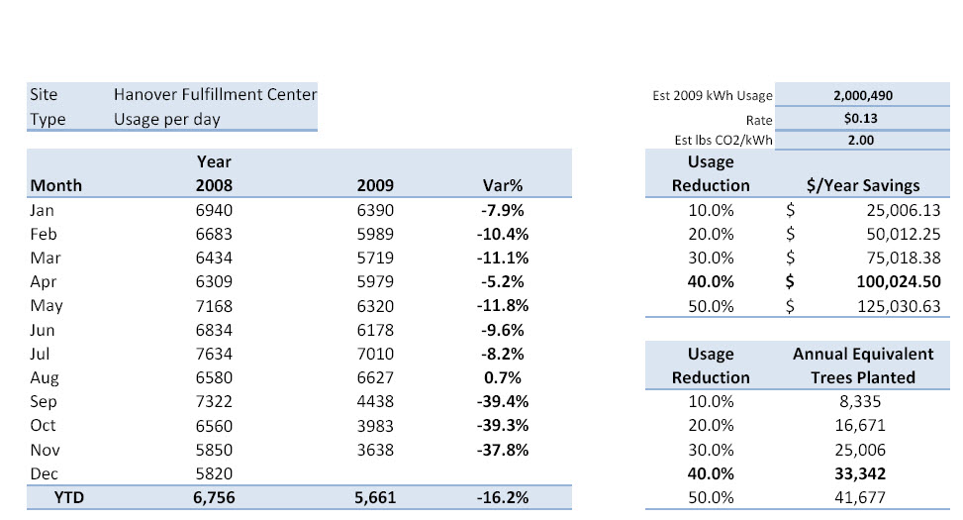
Electric Usage Report
Year-over year usage/day comparison

Slide 18






Fortune 100s
Choose GreenTech
  CLEP certified team = quality design, maximum savings
  OSHA certified installers = safety EMR rating of >1.0
  5,000 plus buildings retrofitted = $ 8,000,000 + in savings
  $20,000,000 in bonding due to a perfect record

